Slide 1

University of North Texas
CSCE 2110
Foundations of Data Structures
Priority Queues

Slide 2
Contents
Priority Queues
Heaps
Heapsort

Slide 3
Priority Queue ADT
Priority Queue is an extension of queue with following properties:
Entries consist of key (priority) and value.
Entries in priority queue are ordered by key
An entry with high key is dequeued before an element with low key.
If two entries have the same key, they are served according to their order in the queue.
Notes:
大家都知道普通队列（Queue）是‘先来先服务’的结构，先进来的元素先出去，对吧？但是优先队列就不一样了，它在这个基础上加上了一个**优先级（priority）**的概念
首先，队列中的每个元素不再只是一个值（value），而是一个键值对（key, value）。这个 key 就代表优先级。其次，整个队列是按照 key 的顺序排的。也就是说，key 越高，优先级越高。
当我们取元素（dequeue）的时候，系统不会按进入顺序来取，而是会先取优先级最高的那个元素。如果有两个元素的优先级相同，那就恢复到普通队列的规则：谁先来谁先出。
简单来说，普通队列是‘排队’，而优先队列是‘按权重排队’。比如在操作系统里面，有些process或者thread更加重要，那么key就更大，就会先处理”

Slide 4
Priority Queue ADT
A typical priority queue supports following operations:
insert(key, value): Inserts an item with given key.
min/max(): Returns the smallest/largest key item.
removemin()/removemax(): Removes the smallest/largest key item.
Notes:
insert(key, value)：插入一个元素。这里我们要指定它的 key，也就是优先级。系统会自动把它放到正确的位置上，保证整个队列按 key 排好。
min() / max()：这两个函数是用来查看队列里优先级最高或者最低的元素。注意，这两个操作只是“看”，不会真的把元素取走。
removemin() / removemax()：这两个才是删除并返回的操作。比如 removemax() 会把优先级最高的那个元素拿出来并从队列里删掉。

Slide 5
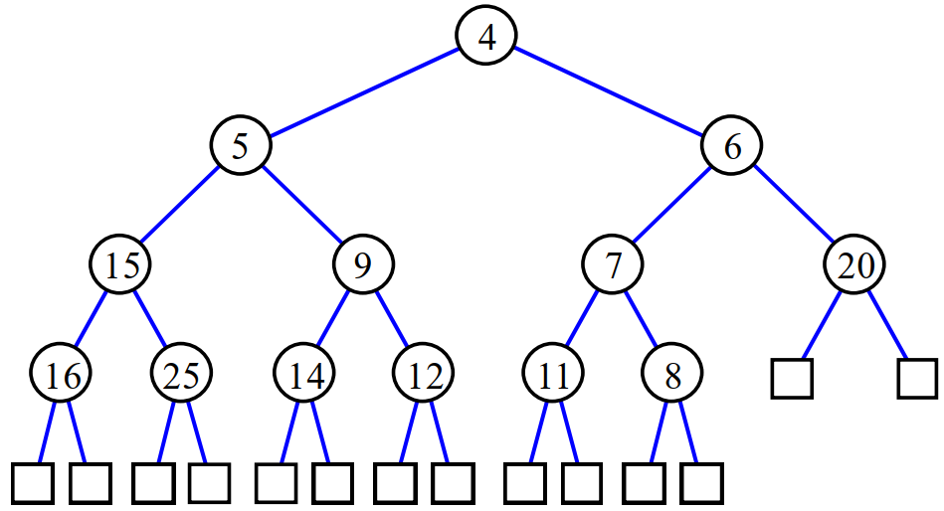
Heap
Tree-based data structure
A complete tree
every level, except possibly the last, is filled, and all nodes are as far left as possible
Satisfies the heap property:
if 𝑃 is a parent node of 𝐶, then the key of 𝑃 is either greater than or equal to (in a max heap) or less than or equal to (in a min heap) the key of 𝐶.
Notes:
我们来看一下 Heap，中文一般叫‘堆’，它是实现优先队列最常用的一种数据结构。
首先，堆是一种 基于树（tree-based） 的结构。注意，这里的树并不是普通的二叉搜索树（BST），而是一种完全二叉树（complete tree）
也就是 heap property（堆性质）。 它规定了父节点（Parent）和子节点（Child）之间的关系：
如果是 最大堆（max heap），那每个父节点的值都大于或等于它的子节点；
如果是 最小堆（min heap），那每个父节点的值都小于或等于它的子节点。

Slide 6
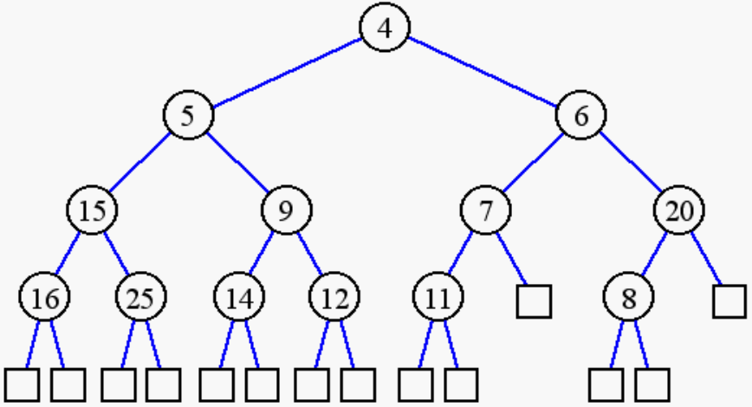
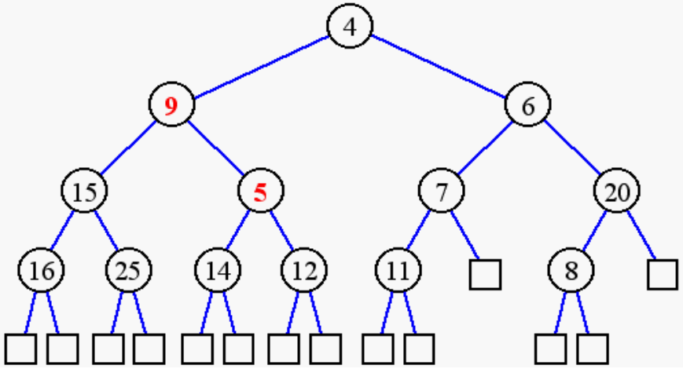
Heap
(min) Heap or Not a (min) Heap?

Slide 7
Heap
(min) Heap or Not a (min) Heap?
Min heap
NOT a min heap

Slide 8
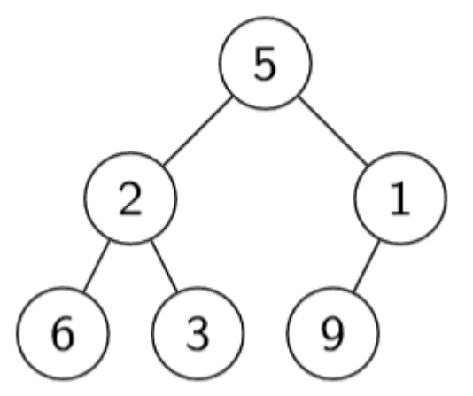
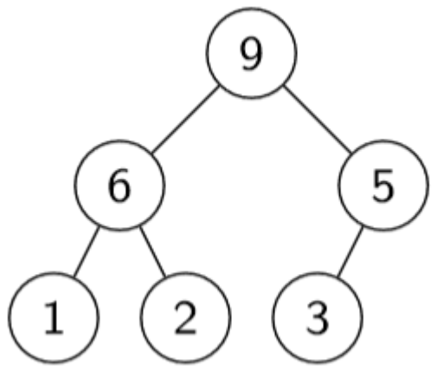
Heaps – Max Heap
A max heap is a heap such that for each node except the root, the parent of node 𝑖 is greater than or equal to node 𝑖 (max-heap property)
Notes:
在最大堆中，每个节点的值都要小于或等于它的父节点的值。 换句话说，父节点永远比子节点‘大’。

Slide 9
Heaps – Max Heap
A max heap is a heap such that for each node except the root, the parent of node 𝑖 is greater than or equal to node 𝑖 (max-heap property)
NOT a max heap
Max heap
For max heap, where is the largest element?
where is the smallest element?
Notes:
那我们来思考一个问题： 在最大堆中，最大元素在哪里？ 很简单——就在根节点（root）。 因为整个堆就是为了保证父节点比孩子大。
那最小元素呢？ 它一定在最底层的某个叶子节点，因为那一层的节点没有孩子，值不会再小下去了。

Slide 10
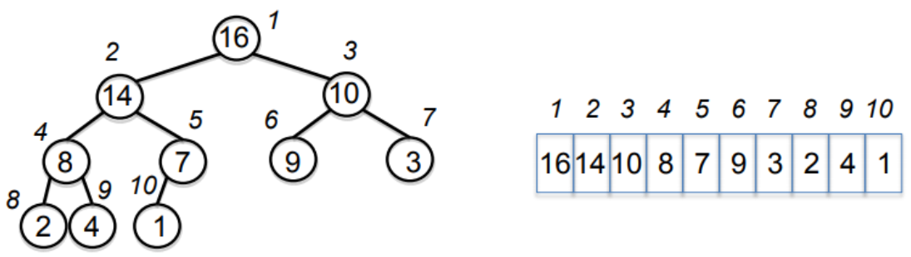
Binary Heap
An array, visualized as a complete binary tree
Often refer as heap
Height of a binary heap is 𝑂(lg 𝑛)
Notes:
如果这个complete tree同时也是一个binary tree，那么我们就得到了最常用的binary heap。
其实，当我们在程序里实现堆的时候，并不会真的用树这种结构去存，而是用数组（array）。
那为什么可以这样做呢？ 因为堆其实是一棵 完全二叉树（complete binary tree），每一层都是从左到右依次填满的，没有空洞。 这种结构就非常适合用数组来存储——我们只要用下标来表示节点的位置，就能很方便地找到它的父节点和子节点。

Slide 11
Heap as a Tree
root of tree: first element in the array, corresponding to 𝑖 = 1
parent(𝑖)= 𝑖/2: returns the index of node's parent
left(𝑖)= 2𝑖: returns the index of node's left child
right(𝑖)= 2𝑖 + 1: returns the index of node's right child

Slide 12
Heap as a Tree
root of tree: first element in the array, corresponding to 𝑖 = 1
parent(𝑖)= 𝑖/2: returns the index of node's parent
left(𝑖)= 2𝑖: returns the index of node's left child
right(𝑖)= 2𝑖 + 1: returns the index of node's right child
Notes:
堆其实是用数组实现的，现在这页就告诉我们——数组里的元素，其实是可以‘想象成’一棵树的
根节点（root of tree） 就是数组的第一个元素，也就是下标 i = 1 的那个。所以堆的顶部其实对应数组的第一个位置
parent(i) = i / 2：表示节点 i 的父节点在位置 i/2（取整）
left(i) = 2i：表示节点 i 的左孩子在位置 2i
right(i) = 2i + 1：表示右孩子在位置 2i + 1

Slide 13
Heap Operations
For max heap:
max: return the maximum item
extract_max: return and remove the maximum item
build_max_heap: produce a max-heap from an unordered array
max_heapify: correct a single violation of the heap property in a subtree at its root
insert
heapsort

Slide 14
max_heapify
Assume that the trees/subtrees rooted at left(𝑖) and right(𝑖) are max-heaps
If element 𝐴[𝑖] violates the max-heap property, correct violation by “trickling” element 𝐴[𝑖] down the tree, making the subtree rooted at index 𝑖 a max-heap

Slide 15
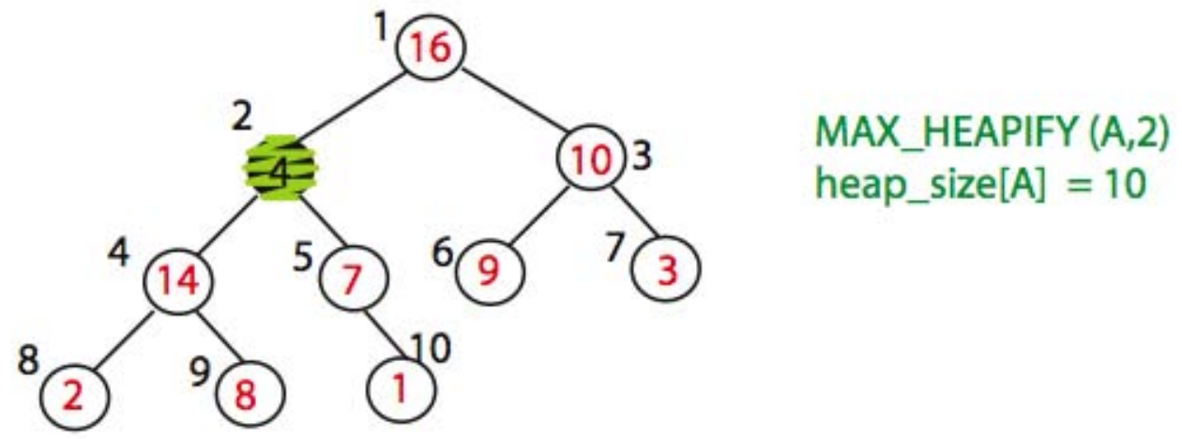
max_heapify: example

Slide 16
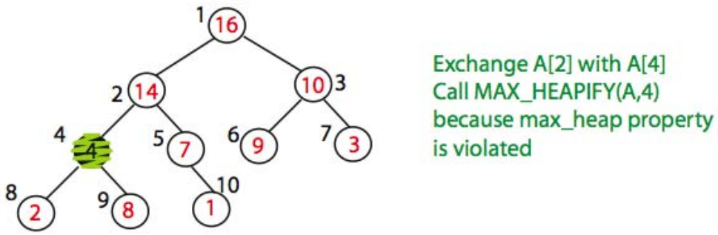
max_heapify: example

Slide 17
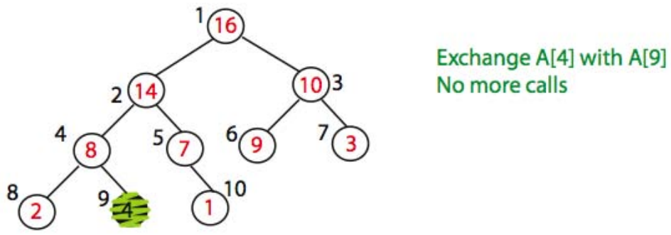
max_heapify: example

Slide 18
max_heapify: pseudocode
max_heapify(A, i):
l = left(i)
r = right(i)
if (l <= heap-size(A) and A[l] > A[i])
then largest = l else largest = i
if (r <= heap-size(A) and A[r] > A[largest])
then largest = r
if largest != i
then exchange A[i] and A[largest] max_heapify(A, largest)

Slide 19
build_max_heap(A)
Converts 𝐴[1 … 𝑛] to a max heap
build_max_heap(A):
for i=n/2 down to 1
do max_heapify(A, i)

Slide 20
build_max_heap(A)
Converts 𝐴[1 … 𝑛] to a max heap
build_max_heap(A):
for i=n/2 down to 1
do max_heapify(A, i)
Why start at 𝑛/2?

Slide 21
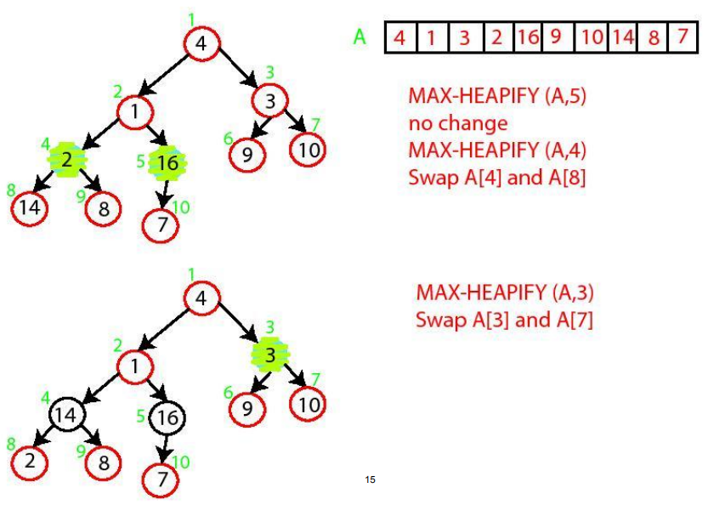
build_max_heap Demo

Slide 22
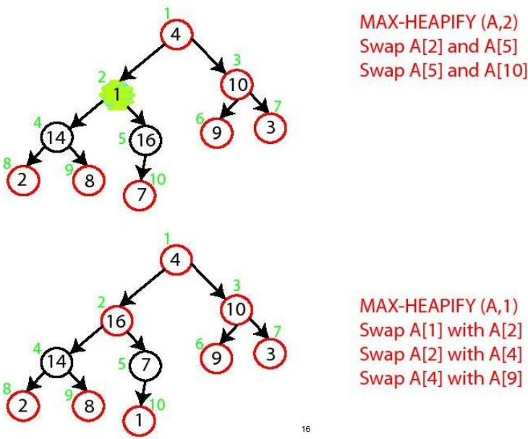
build_max_heap Demo

Slide 23
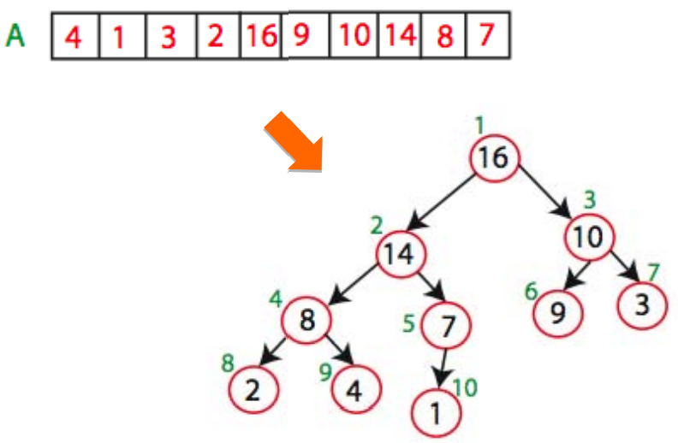
build_max_heap Demo

Slide 24
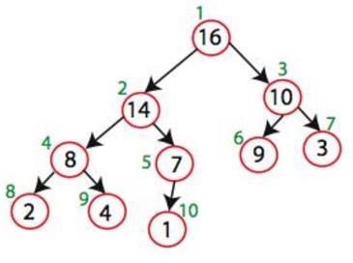
Insert
𝑖𝑛𝑠𝑒𝑟𝑡(𝑘)
Let X be the new entry k
Place X at the bottom level of the tree, at first free spot from left; i.e., first free location in array
Bubbles up tree until heap property is satisfied (max-heapify)
Repeat:
Compare X’s key with its parent’s key
If X’s key is larger, exchange

Slide 25
True or False
A max heap forms, if keys 2^{𝑘−1} to 1 are inserted in order into an initially empty array.

Slide 26
max
?

Slide 27
max
Return entry at root

Slide 28
extract_max
Return and remove entry at root
Save item at root for return value
Fill root with last item “X” in tree
Bubble “X” down the heap (max-heapify)
Repeat: If X < one or both of its children, swap X with its maximum child

Slide 29
Heapsort
How does knowing the maximum element of an array 𝐴 help in sorting 𝐴?
Build a heap for A
Get the maximum
Put it in place (exchange with the last item)
Update the heap accordingly, reduce size, max-heapify
Get the new maximum
Put it in place
Update the heap accordingly, reduce size, max-heapify
...

Slide 30
Heapsort
Sorting Strategy:
Build Max Heap from unordered array;
Find maximum element 𝐴[1];
Swap elements 𝐴[𝑛] and 𝐴[1]: now max element is at the end of the array!
Discard node 𝑛 from heap (by decrementing heap-size variable)
New root may violate max heap property, but its children are max heaps. Run max_heapify to fix this.
Go to Step 2 unless heap is empty.

Slide 31
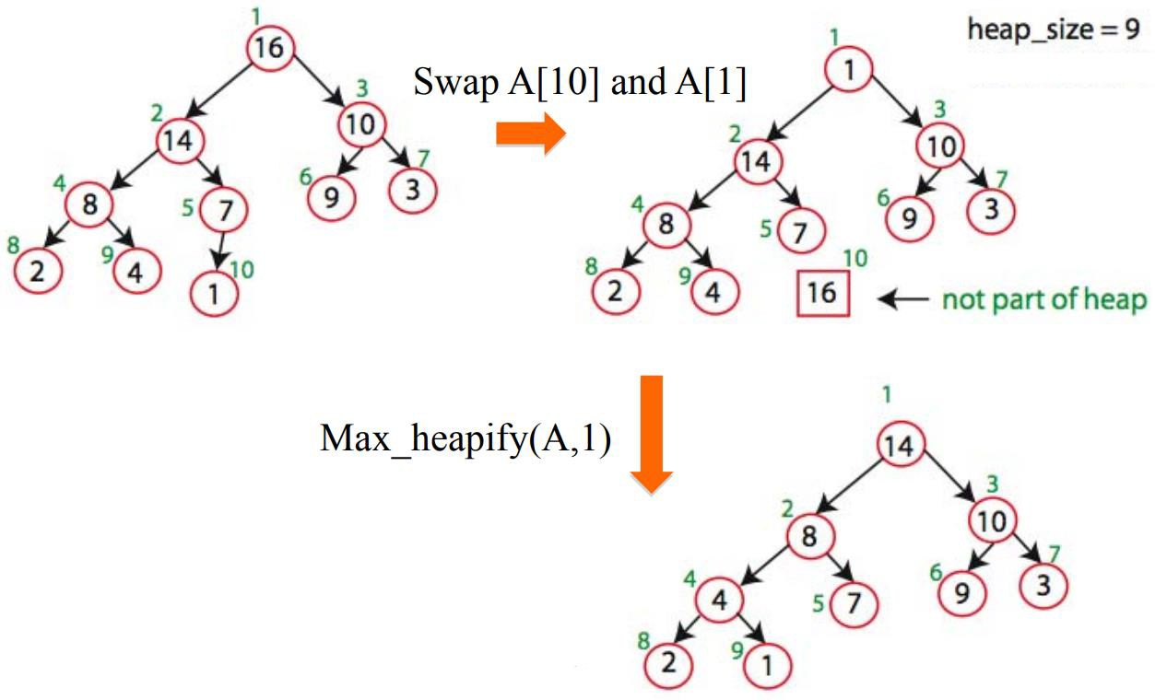
Heapsort Demo

Slide 32
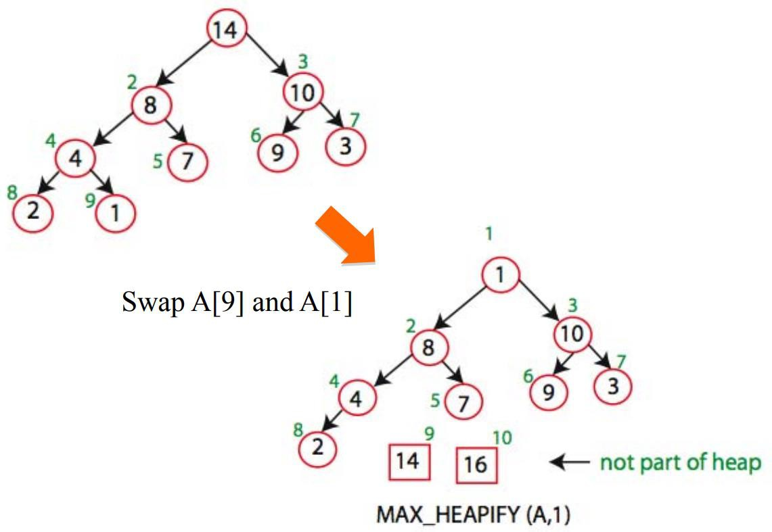
Heapsort Demo

Slide 33
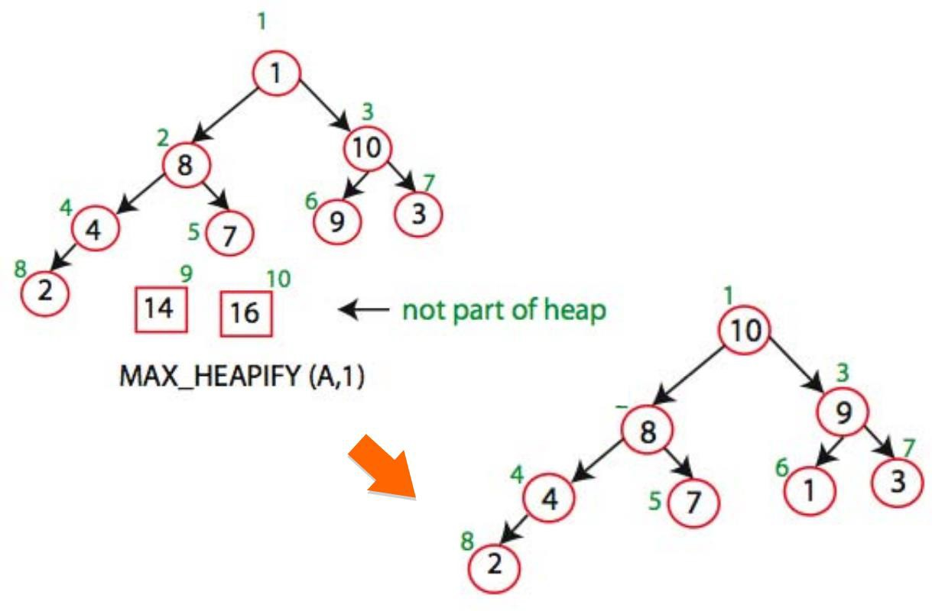
Heapsort Demo

Slide 34
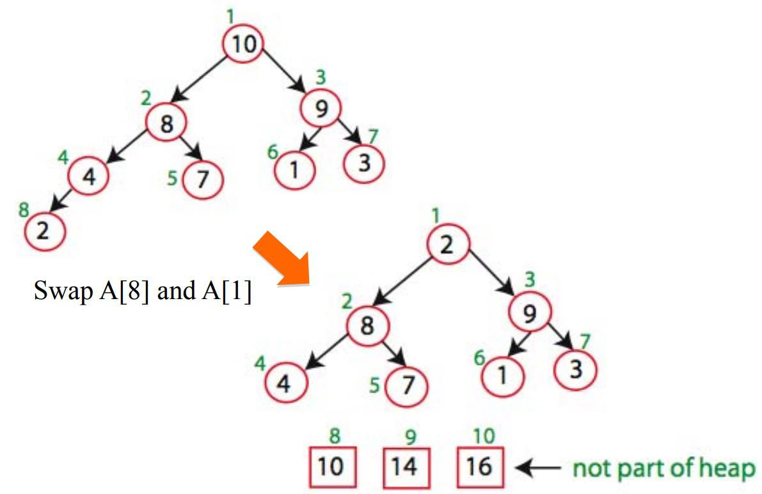
Heapsort Demo

Slide 35
Heapsort
after 𝑛 iterations the Heap is empty
every iteration involves a swap and a max_heapify operation;

